Slide 1




DIGITAL LITERACY
SKILLS
BASIC USERS

Slide 2
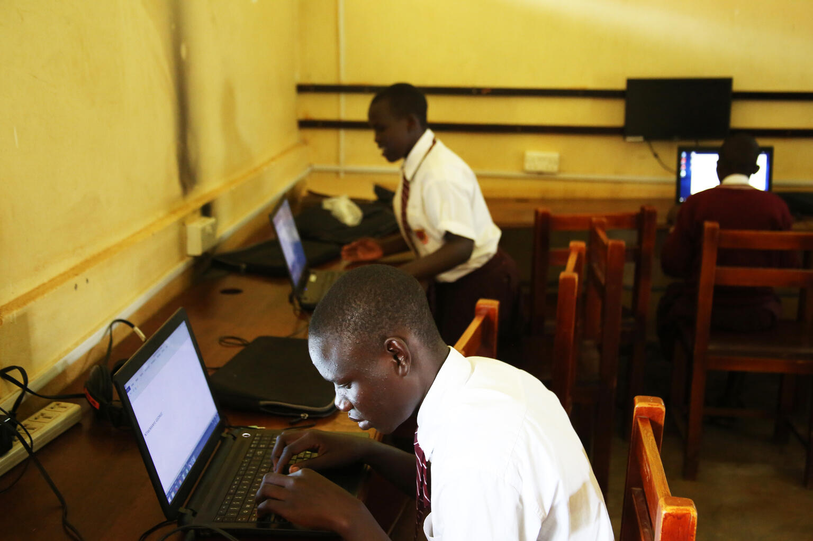
Module 6
Problem solving

Slide 3

3
Unit 3: Creatively using digital technologies

Slide 4

Digital creativity
Creativity is one of the most highly valued traits of the 21st century.
Digital creativity is a rapidly growing field.
Digital creativity is more than the sum of digital + creativity.

Slide 5
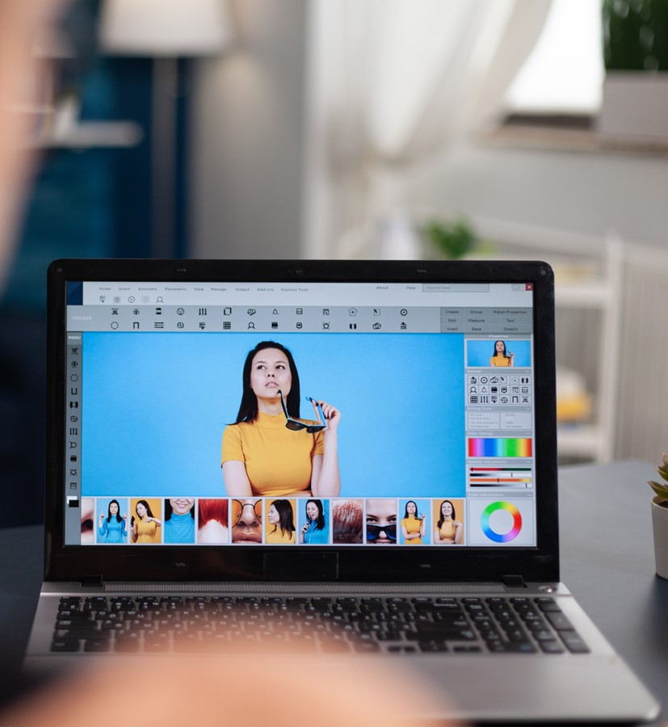
Digital creativity tools
Text editing
Photo editing app
Calendars
Social media apps

Slide 6
Skills to practise
Solve problems using digital skills
Open a program that you often use. Click on the ‘help’ icon and search for a solution to your problem, e.g., How to change a font’. Follow the steps shown.
Note that most programs and apps with a help function are linked to the internet. You should be linked to the internet when using this function.

Slide 7
All back covers should include
contact information of the section
producing the work.
© United Nations Children’s Fund (UNICEF) [month and year of publication]

